Slide 1
POWERSHELL + MSAL
(Almost) Everything you need to know about authenticating to Azure.

Slide 2



Ben Reader
Ben Whitmore
Code monkey, Patch My PC
Handsome guy (20yrs ago), Patch My PC
@powers_hell
@byteben

Slide 3
Death by slides
(a joke by B1)

Slide 4
Summary time
Authentication seems hard… Why?
What tools exist to make authentication… not seem hard?
Authentication + MFA
What the hell is an auth token?
HELP! My device doesn’t have a keyboard (Device Code Authentication)
Passwords are stupid – or how to learn to love client secrets…
Client secrets are stupid – stop being scared of certificates…
Credentials are stupid – just use managed identities!
Extra credit?????

Slide 5
Basic authentication.
(raw dogging the internet)

Slide 6
Pre-Reqs to make our lives better
VS Code // Windows Terminal.
PowerShell 5 ( or PowerShell 7 if you are cool – YOU ARE COOL).
MSAL.PS
“Install-Module MSAL.PS”
https://www.powershellgallery.com/packages/MSAL.PS
THAT’S IT.

Slide 7
Interactive authentication.
Getting an auth token the MSAL.PS way.

Slide 8
Device code authentication.
Or how to authenticate to Graph on your TV…?

Slide 9
Non-Interactive Authentication.
Stop being paid to do busy work and make computers work for you… or something…

Slide 10
Certificate based authentication.
You left your client secret in your source code… didn’t you?

Slide 11
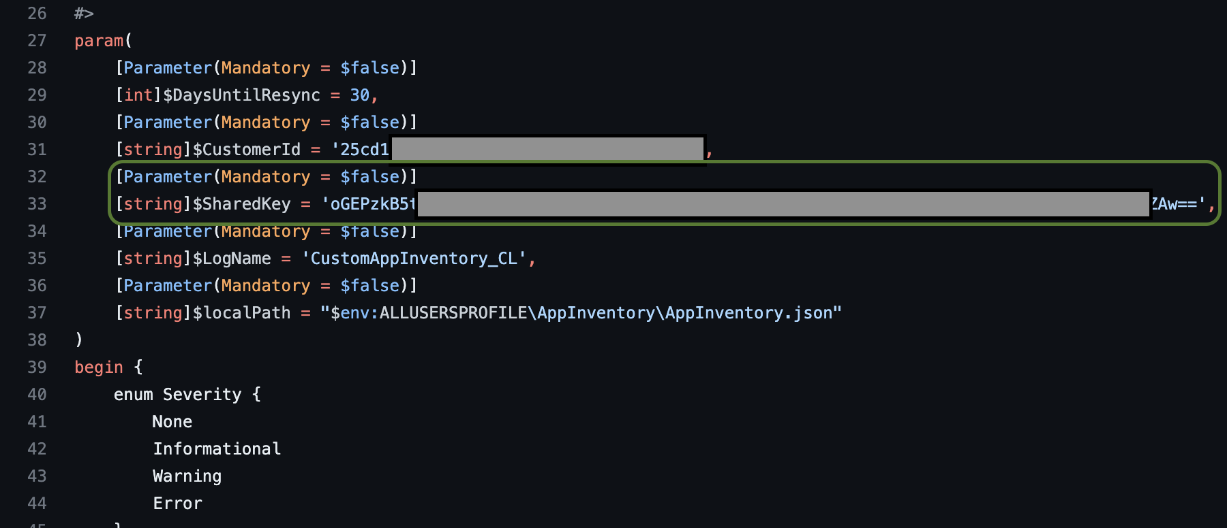
Does this look familiar?

Slide 12
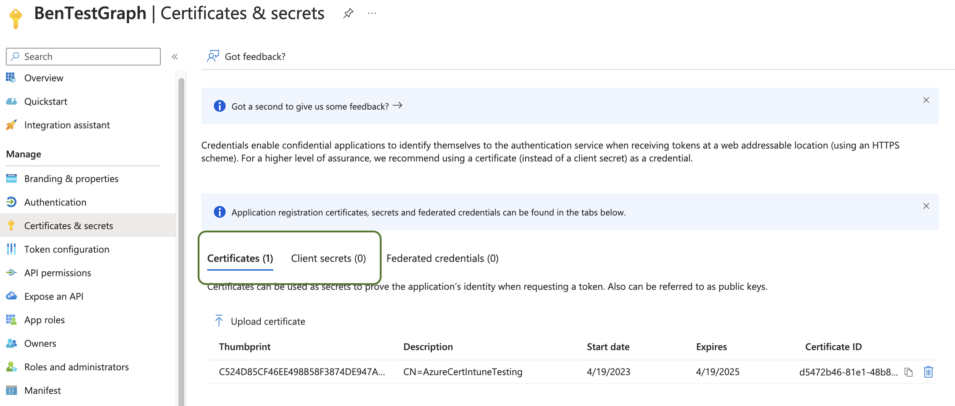

Certificates - This is the way
Notes:
Show app registration

Slide 13

This is the way – why?
Certificate authentication provides an extra layer of security as it uses a public-private key pair to authenticate the application rather than a secret key, which can be stolen or compromised.
Certificates can be securely stored in Azure Key Vault or a computer certificate store, reducing the risk of exposure compared with storing client secrets in configuration files, scripts or databases.
Notes:
Show app registration

Slide 14

This is the way – why?
Certificate authentication is compliant with industry security standards like FIPS 140-2, which is a requirement in many regulatory compliance frameworks.
Since certificates are stored securely on the server side and not transmitted over the network, there is a reduced risk of accidental exposure or leaks compared with using client secrets.
Notes:
Show app registration

Slide 15
Create a certificate
$subjectName = "AzureCertIntuneTesting"
$certStore = "LocalMachine"
$validityPeriod = 24
$newCert = @{
Subject = "CN=$($subjectName)"
CertStoreLocation = "Cert:\$($certStore)\My"
KeyExportPolicy = "Exportable"
KeySpec = "Signature"
NotAfter = (Get-Date).AddMonths($($validityPeriod))
}
$Cert = New-SelfSignedCertificate @newCert

Slide 16
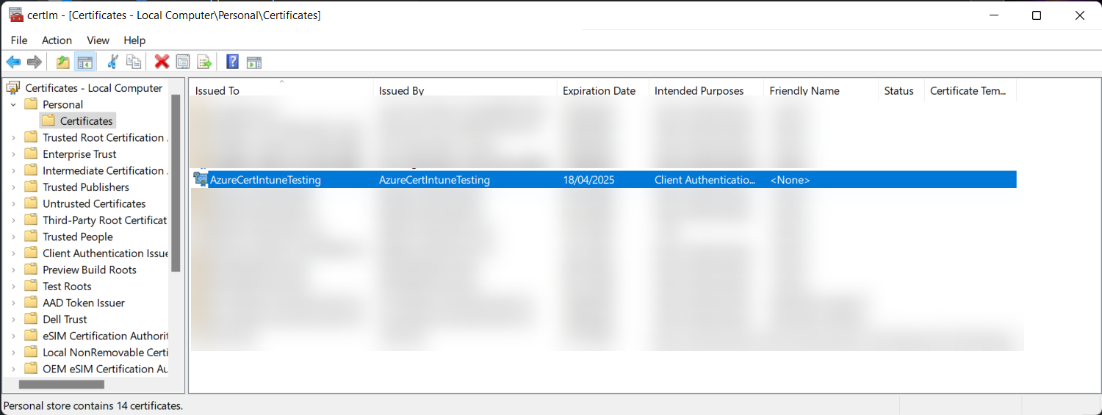
Create a certificate

Slide 17
Export the public key
$certFolder = "C:\temp\certs"
$certExport = @{
Cert = $Cert
FilePath = "$($certFolder)\$($subjectName).cer"
}
Export-Certificate @certExport

Slide 18
Export the private key (danger)
$certFolder = "C:\temp\certs"
$certThumbprint = $Cert.Thumbprint
$certPassword = Read-Host -Prompt "Enter password for your certificate: " -AsSecureString
$pfxExport = @{
Cert = "Cert:\$($certStore)\My\$($certThumbprint)"
FilePath = "$($certFolder)\$($subjectName).pfx"
ChainOption = "EndEntityCertOnly"
NoProperties = $null
Password = $certPassword
}
Export-PfxCertificate @pfxExport

Slide 19
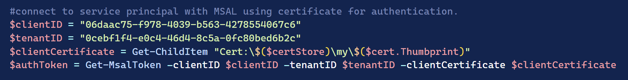
Connect with the Certificate
Upload public portion to the app registration

Slide 20
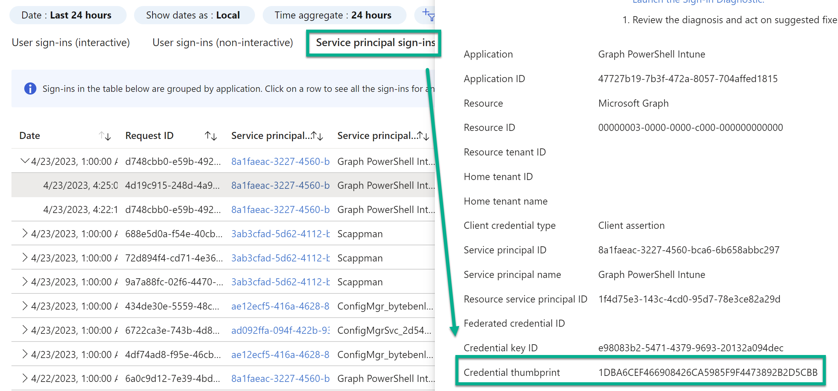
Connect with the Certificate

Slide 21
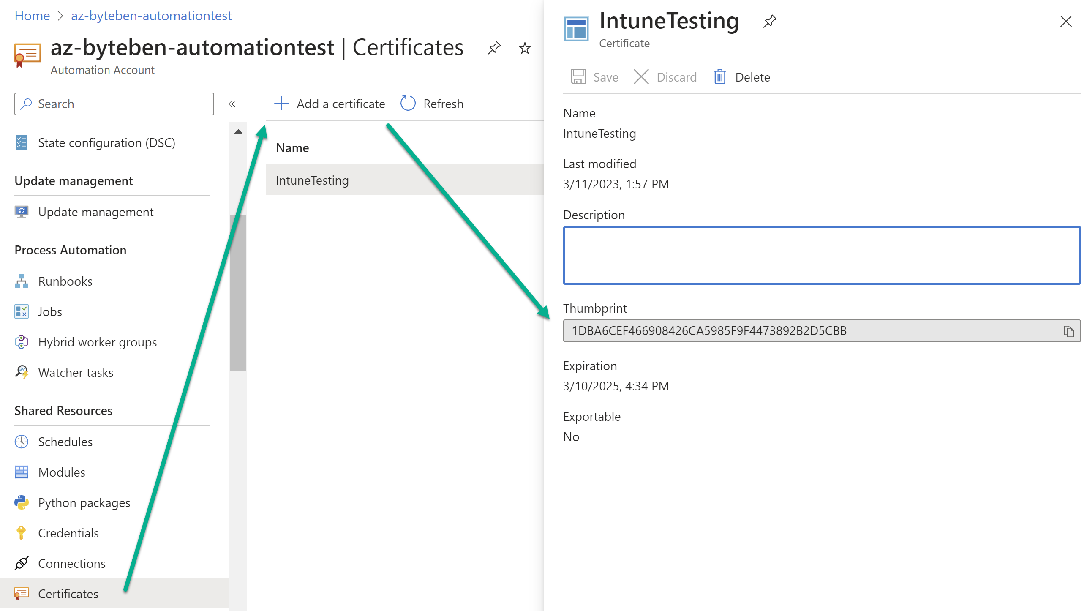
Certificate with Azure Automation

Slide 22
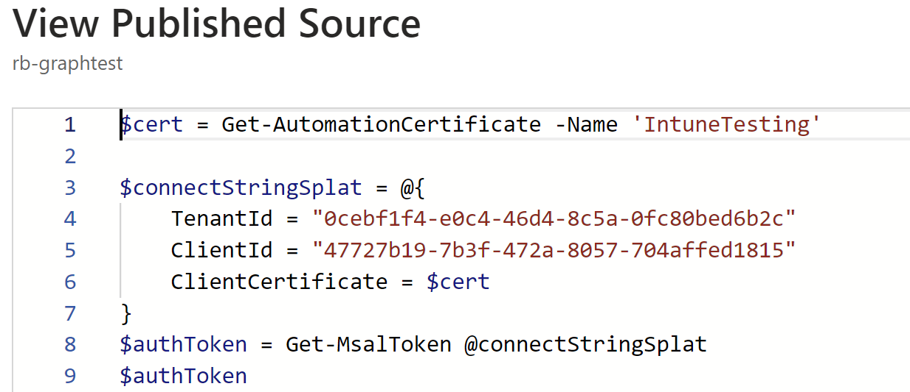
Certificate with Azure Automation

Slide 23
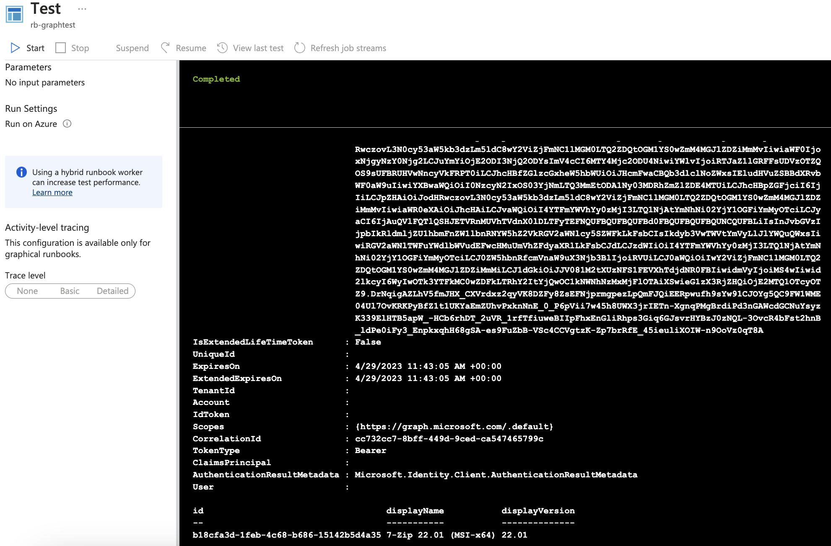
Certificate with Azure Automation
Access Token
Graph call worked Ben

Slide 24
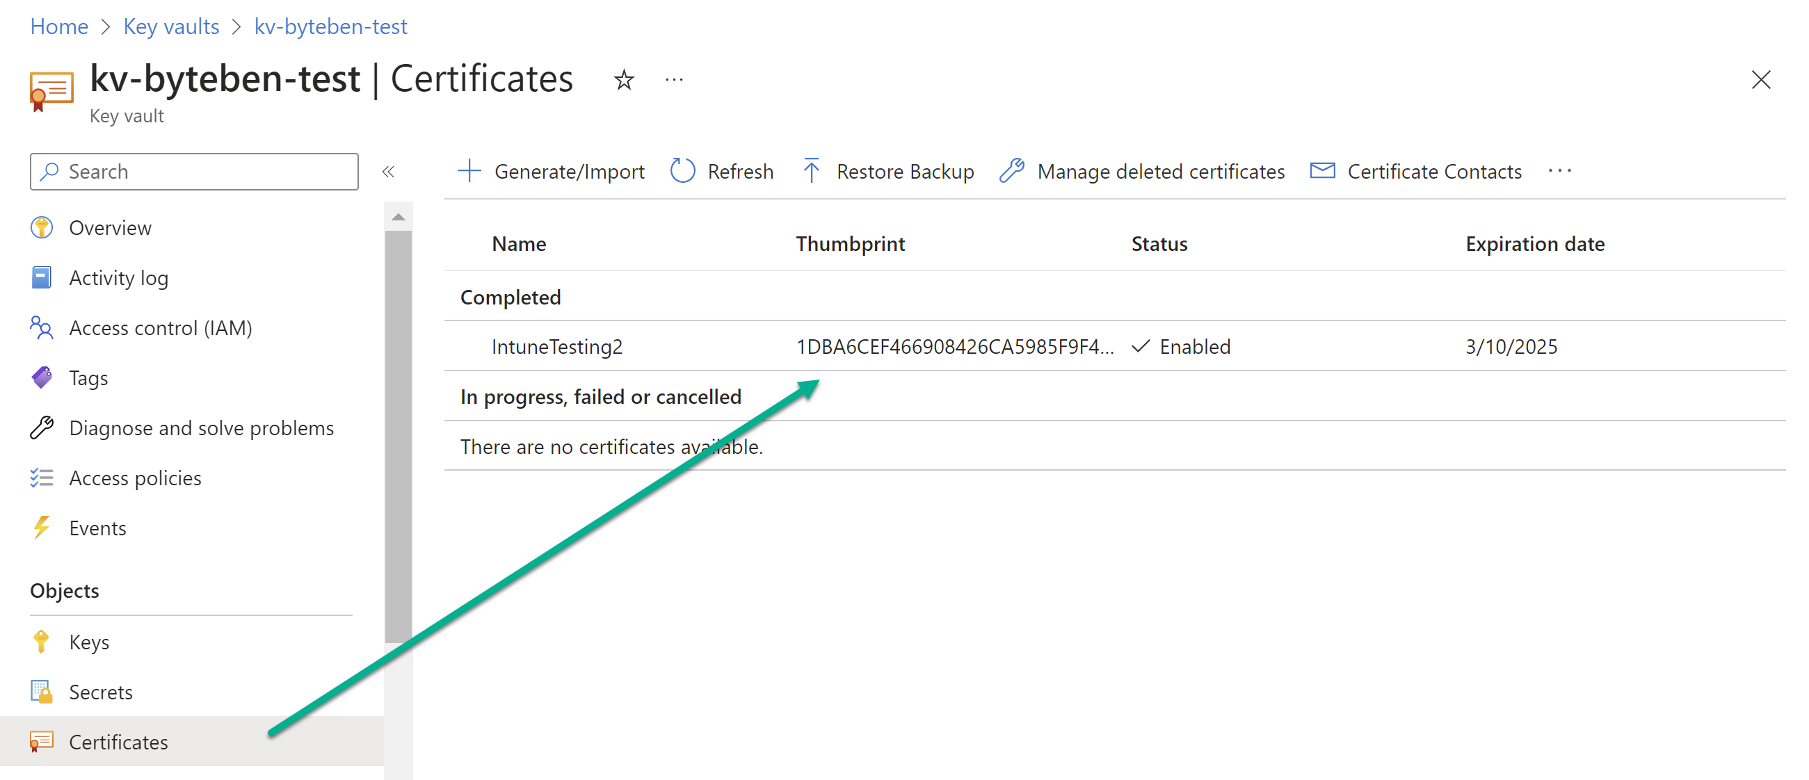
Certificate with Azure Automation & Key Vault

Slide 25
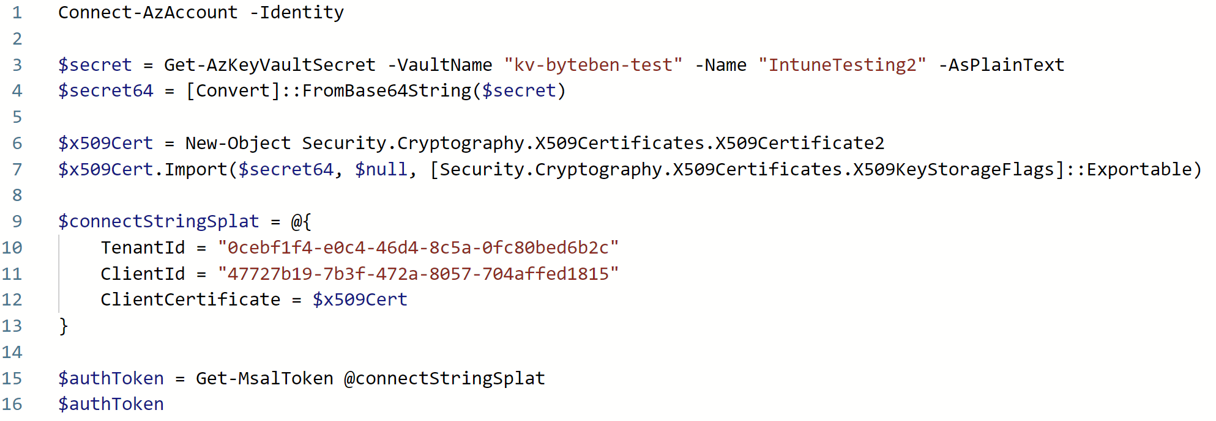
Certificate with Azure Automation & Key Vault

Slide 26
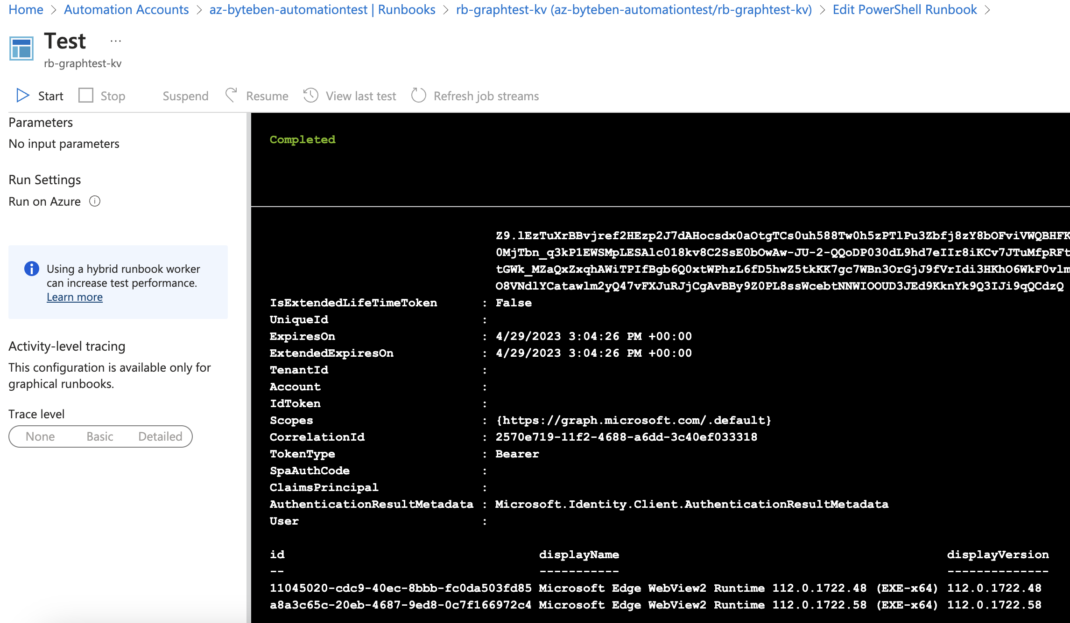
Certificate with Azure Automation & Key Vault
Access Token
Graph call worked Ben

Slide 27

Why are you using certs in Azure Automation, Ben(s)?

Slide 28
Managed identities and authentication.
Galaxy brain time.

Slide 29
Showing off with MSAL.PS.
Make your colleagues hate you by being smarter than them.

Slide 30
Summary
Authentication isn’t really that hard.
You are already using MFA – so we don’t need to remind you about that.
Certificates aren’t scary – use them for production workloads.
Managed Identities are cool – if you can, use them.
PowerShell makes all of this comically simple – learn it, love it, use it all the time.

Slide 32
